Slide 2

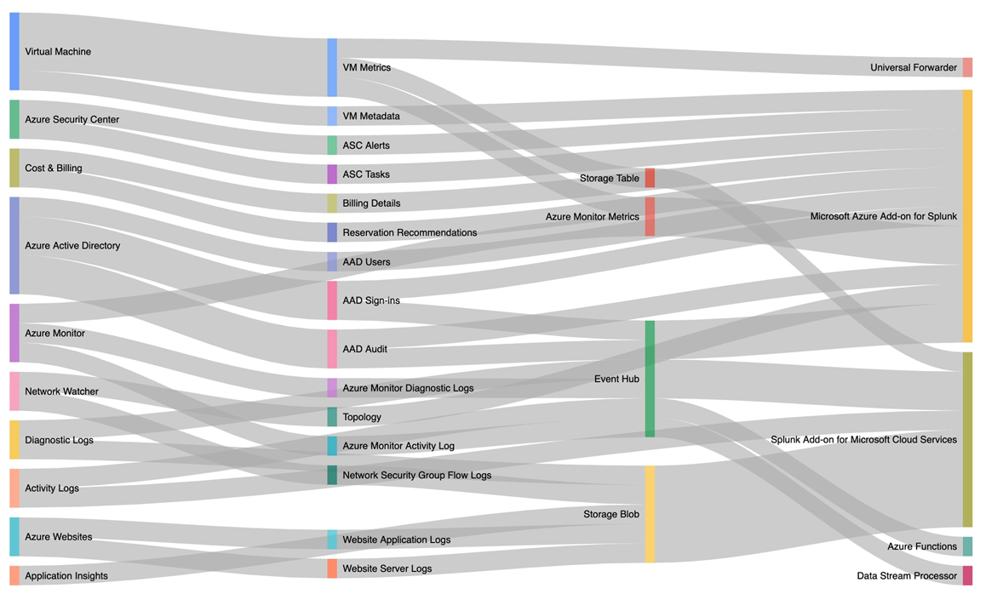
Tools for managing VM’s in Azure
Walk thru and referencing CAF recommendations
Comparing/listing Gassco on-prem tools and requirements
Suggesting a toolset and integrations for future environment

Slide 3
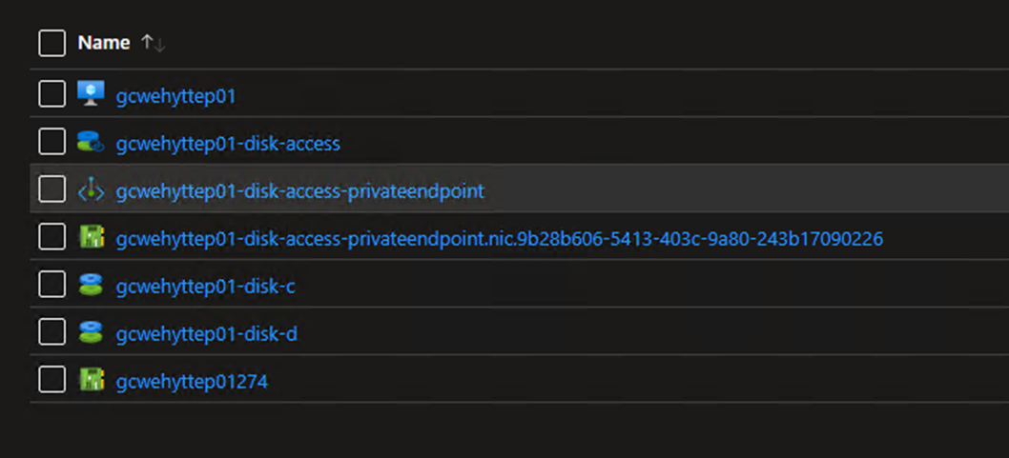
Tools for Disaster recovery on-prem to Azure
CAF only refer to Cloud, and DR in a cloud scenario
Tools in use and familiar to Gassco.
Veeam Backup & Replication
Test restore of byhyttep01

